Slide 1

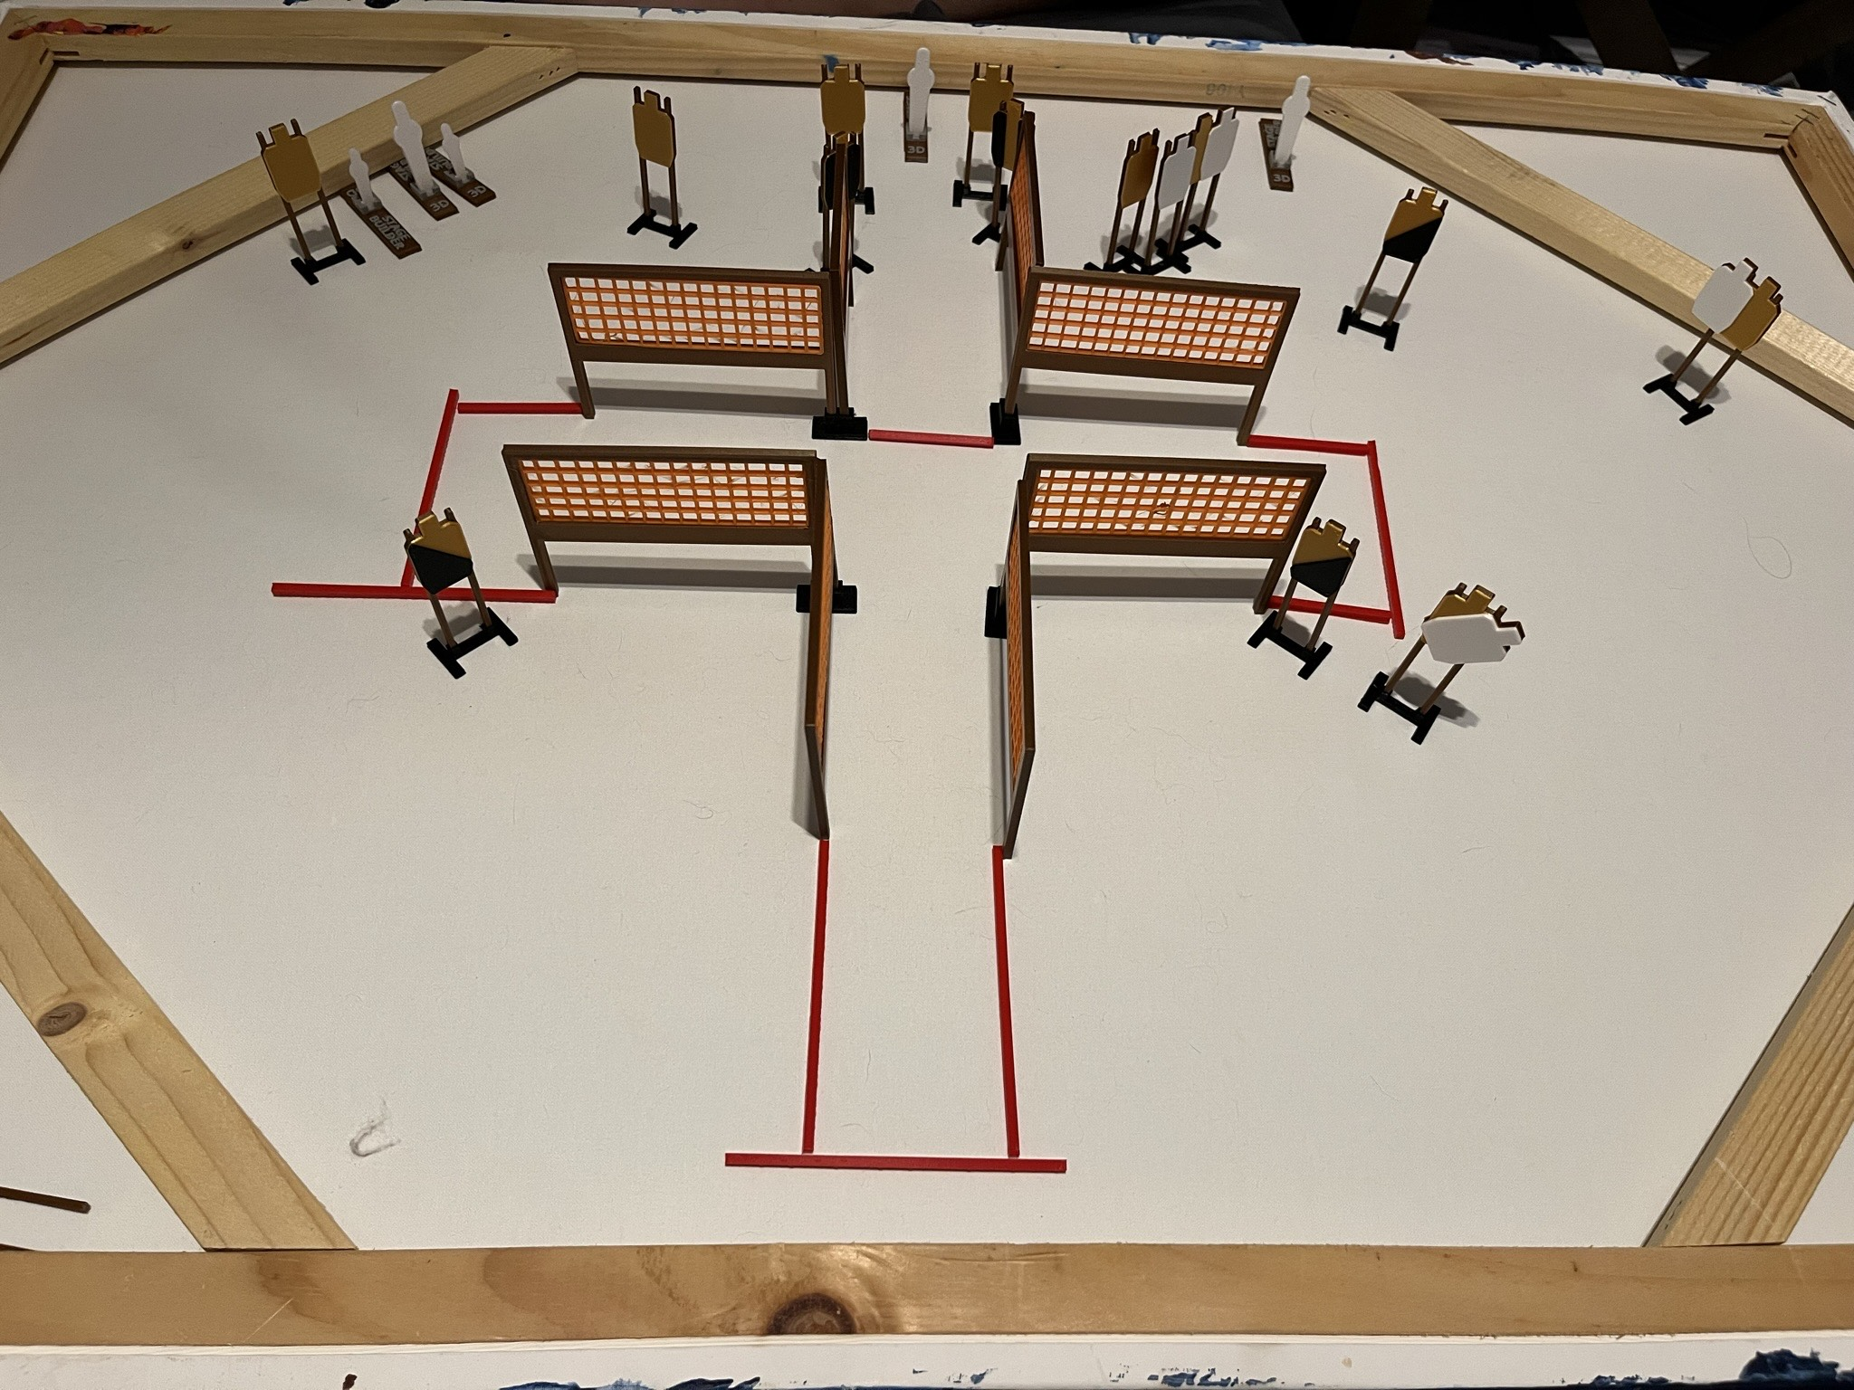
 | Dothan Practical Shooters – USPSA Match Peekaboo Course Designer : Jeremy Stevens Bay: A2
Round Count 31 rounds 13 USPSA 3 colt poppers, 2 mini poppers
Equipment List 12 wall feet 1 left diag, 2 right diag, 2 tuxes 12 targets (8 + 4 NS)

Slide 2
Stage Name
Written Stage Briefing
Scoring: Comstock Rounds: 31
Targets: 13 USPSA, 5 steel
Handgun start position: anywhere completely outside the shooting area, wrists below belt. Handgun is loaded and holstered.
PCC start position: anywhere completely outside the shooting area, stock on belt. Loaded carbine is held with both hands, safety on.
Stage Procedure: on the audible start signal, engage targets as they become available from within the shooting area.

